Slide 1
Heart Disease Prediction System
2105391 Preeti Padma Sahu
21052995 Aniket Burman

Slide 2
Table of Contents
01
02
03
04
05
Introduction
Literature Survey
Methodology and Algorithms
06
Conclusion
Problem Formulation
Experiment and Results

Slide 3
Introduction
Problem Statement:
Given the clinical parameters about the patients, can we predict whether or not they have heart disease?
Overview:
Heart disease or cardiovascular disease is one of the biggest reason for death across the globe. As it is a cause of 35% of total death worldwide.
Early detection of heart disease is crucial for effective prevention and management. Detecting possible heart problems early can prevent disease progression and improve patient outcomes in the long run.

Slide 4
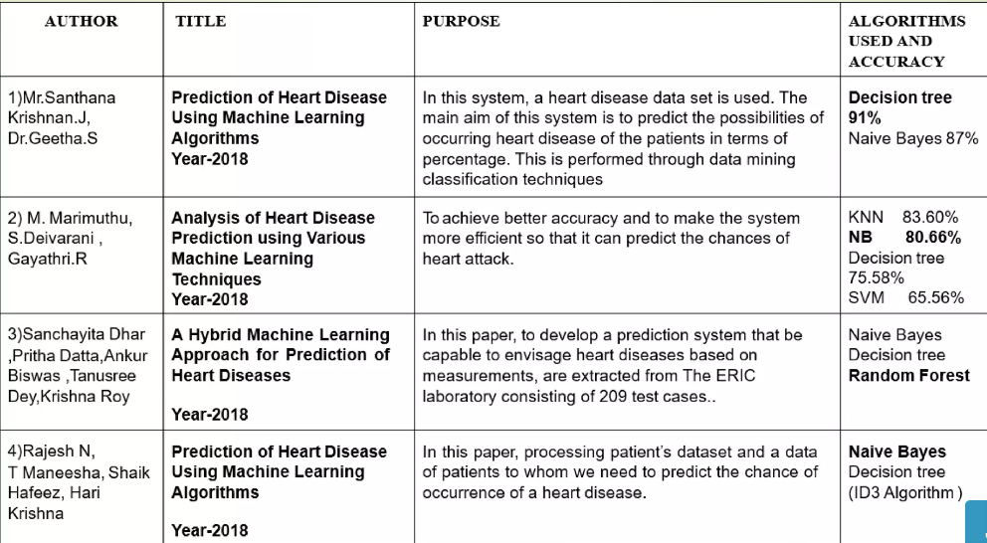
Literature Survey

Slide 5
Approach Methodology
Random Forest
Naive Bayes
Logistic Regression
The Bayes Theorem states that when determining a conditional probability, the final output is determined by each conditional probability.
Naive Bayes classifiers have exceptionally good performance on the grounds that they require a bunch of boundaries that is relative to the quantity of characteristics in a learning issue.
The missing values will be handled by the random forest classifier, which will maintain the detection rate of a large portion of the data.
The Random Forest is made in two stages: the first is to join N choice trees to make the arbitrary timberland, and second is to make any expectations for each tree created in principal stage.
Logistic Regression takes the output of the linear regression function as input and uses a sigmoid function to estimate the probability for the given class.
The output is a categorical or discrete value. It can be either Yes or No, 0 or 1, true or False

Slide 6
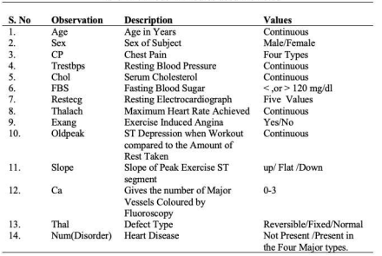
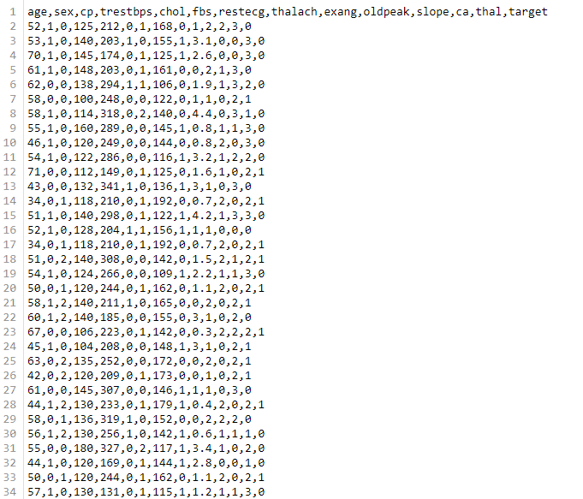
Problem Formulation
Attributes that are taken:
Dataset screenshot:

Slide 7
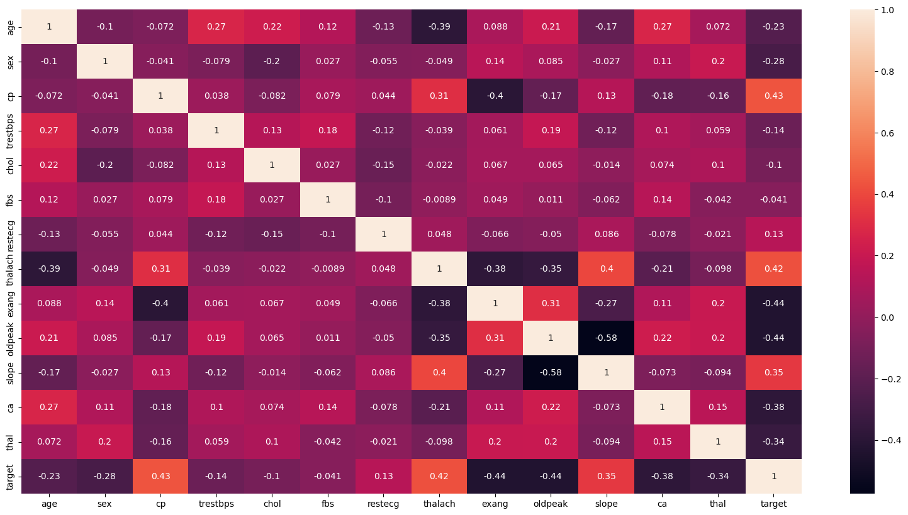
Experiment And Result
Heat Map

Slide 8
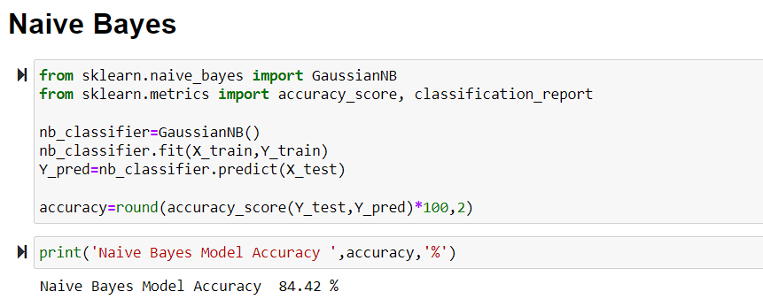
Experiment And Result
Algorithms

Slide 9
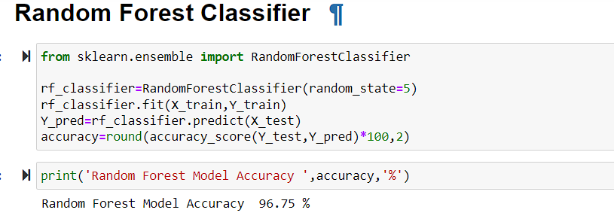
Experiment And Result

Slide 10
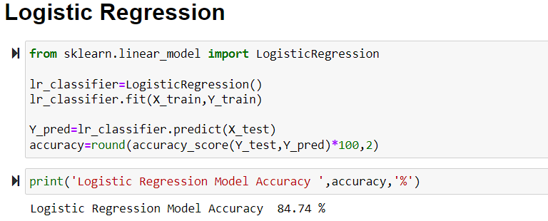
Experiment And Result

Slide 11
Conclusion
Heart disease prediction is challenging and very important in medical field.
However, the mortality rate can be drastically controlled if the disease is detected at early stage and preventive measures are adopted as soon as possible.
The proposed approach is the characteristics of random forest(RF).
The Random Forest approach demonstrated an accuracy of 96.75%.

